Slide 1
What will I do?
This experiment measures your colour perception by asking you to make specific colour adjustments on your mobile devices by downloading an app –
Unique yellow – Pure yellow without any red or green
Unique blue – Pure blue without any red or green
Unique red – Pure red without any yellow or blue
Unique green – Pure green without any yellow or blue
Unique white – Pure white without any other colours

Slide 2


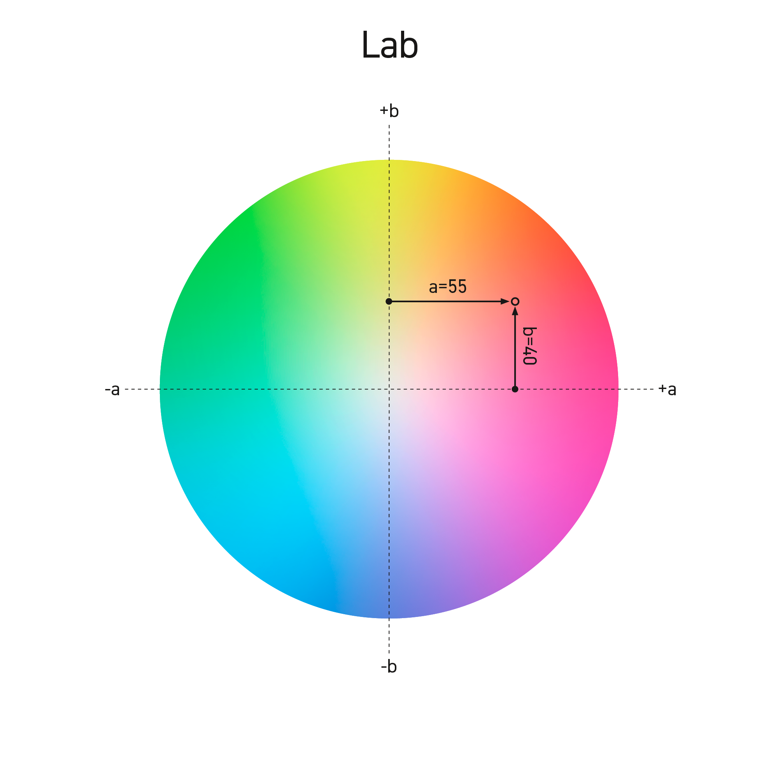
What will I do?
Y+
“Looks a bit red - add green”
R+
White
G+
Submit
Task instructions are provided in the mobile app.
Use landscape.
Use the buttons on the screen to adjust the colour – as shown in example here
Each tap changes the colour very slightly – please take your time and make your settings carefully.
Y+
B+
“Looks a bit blue - add yellow”
R+
White
G+
Submit
Y+
B+
B+
G+
R+
R+
White
G+
Submit
Y+
B+

Slide 3
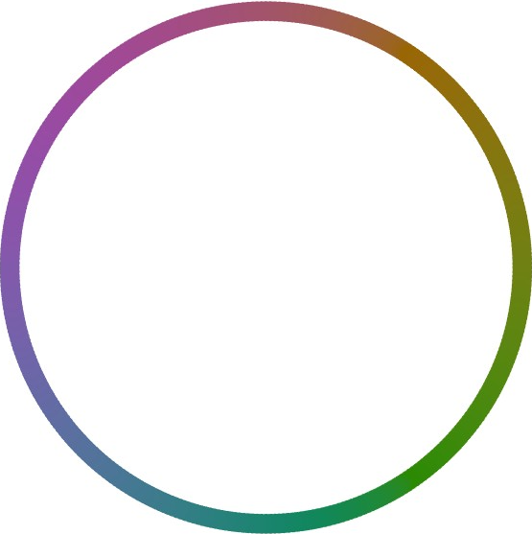
What will I do?
+
“Not quite green – I’ll try pressing minus”
Green
Submit
Task instructions are provided in the mobile app.
Use landscape.
Use the buttons on the screen to adjust the colour – as shown in example here
Each tap changes the colour very slightly – please take your time and make your settings carefully.
-
+
“Ah no! Even less green, back the other way…”
Green
Submit
-
+
Green
Submit
-

Slide 4
What will I do?
You will be given a few practise runs before starting the main task.
Upon completion, you may be invited to also provide optional calibration data.
Calibration involves the researcher (Yesesvi) taking measurements of the colours from your device.

Slide 5
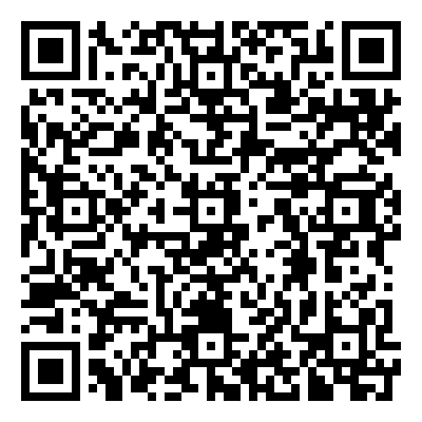
Checklist
https://sussex-psychology-software-team.github.io/Colour-Adjust/colour-adjust.html
Please complete all the adjustments on your mobile phone.
Please carefully follow all the instructions in the app.
Use your phone on landscape.
When you open the app it should appear full screen, with no other status bars or symbols (i.e. no battery icons or signal bars).
Make sure you switch off all screens near you (such as your computer or laptop screen) before starting your colour adjustments.

